Slide 1
Let’s Celebrate our story: First Congregational UCC South Haven, MI A vibrant past and an exiting future
Notes:
“Let’s begin looking at our Narrative Budget by telling First Congregational Church’s “Story”.”

Slide 2
Worship

Slide 3
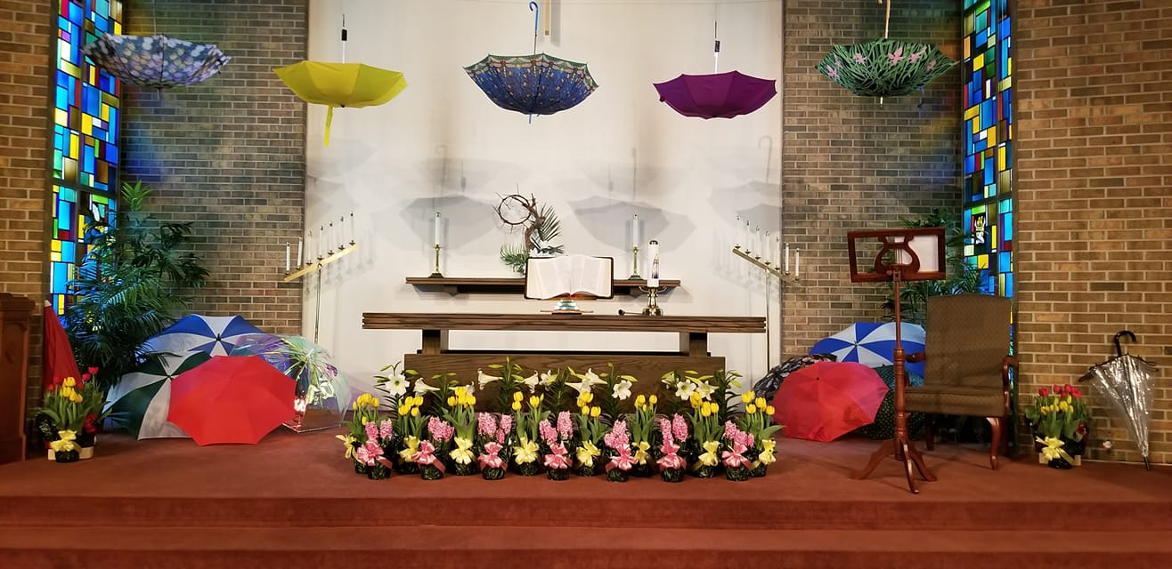
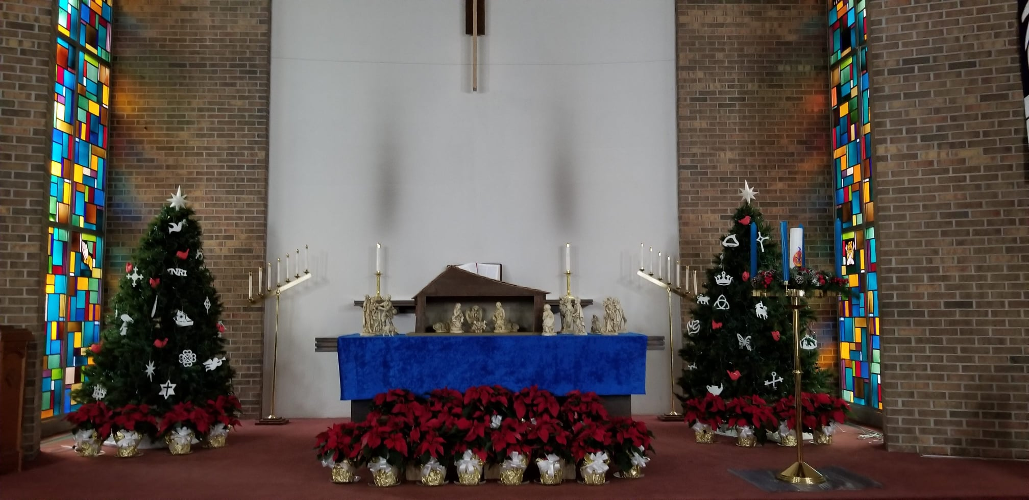
Advent and Christmas Worship

Slide 4
Worship – Lay Assistants

Slide 5
Youth Sunday

Slide 6
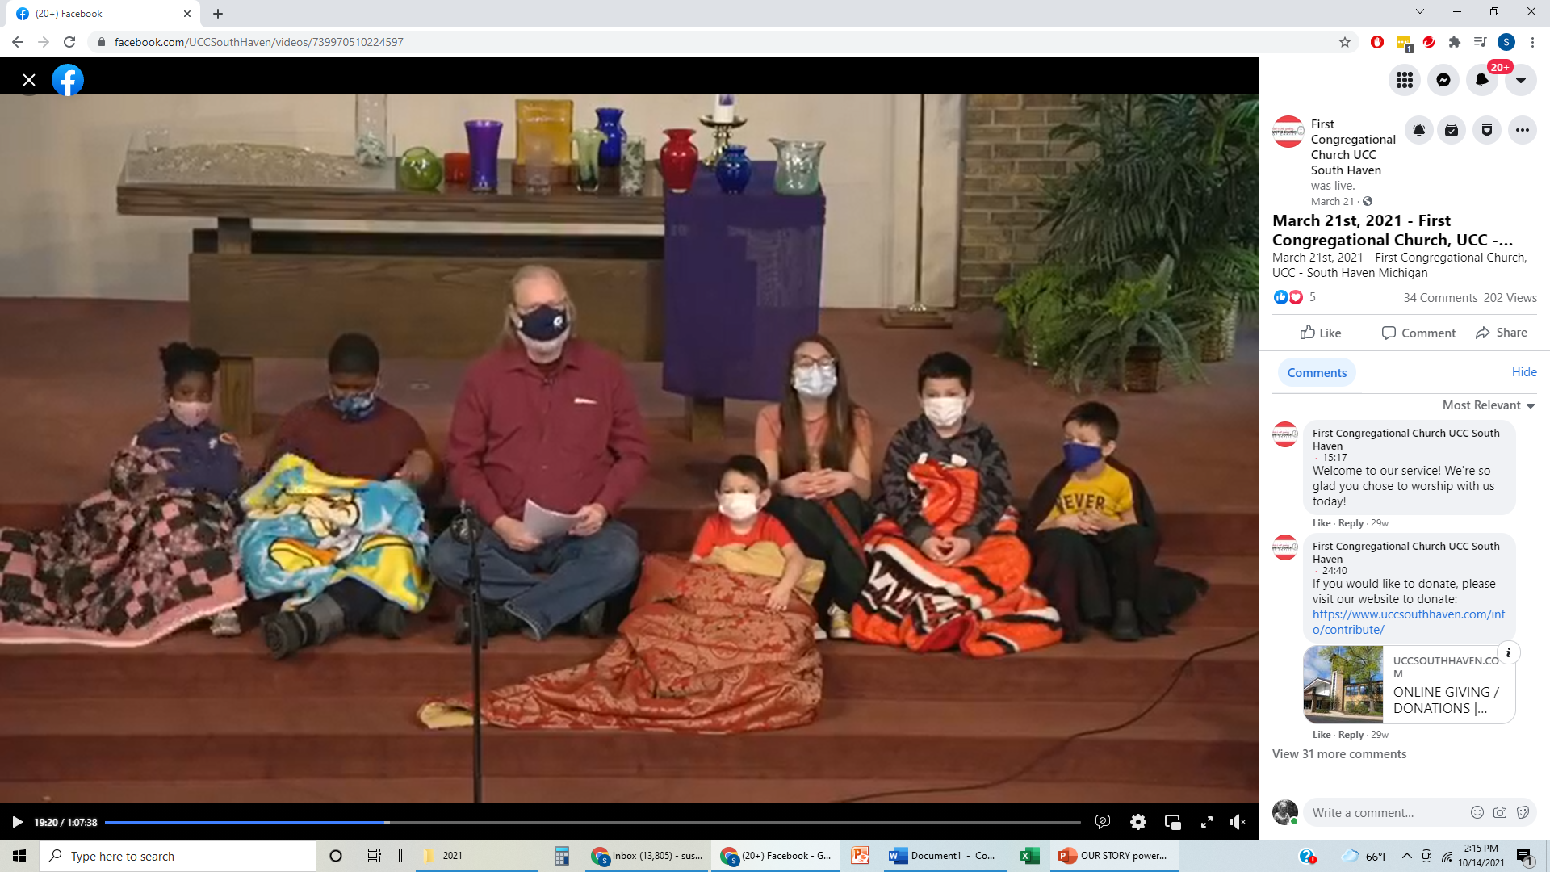
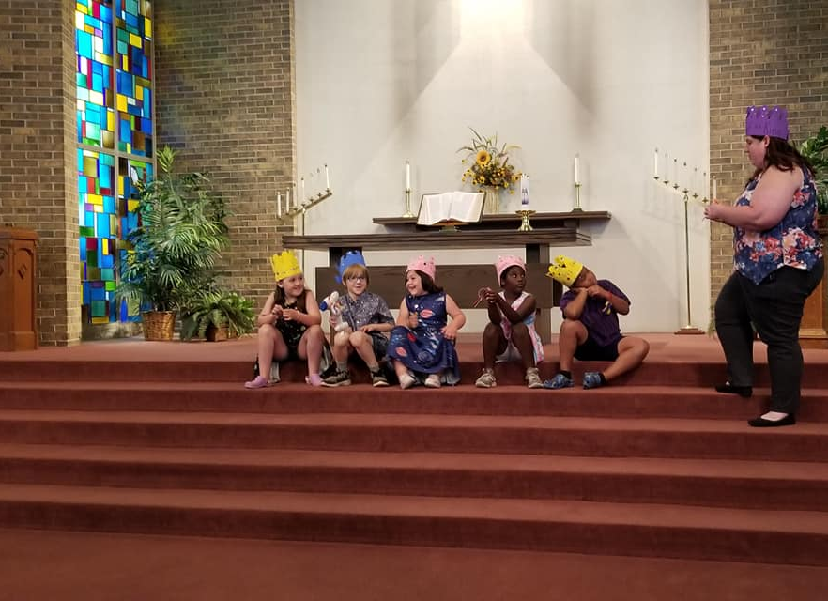
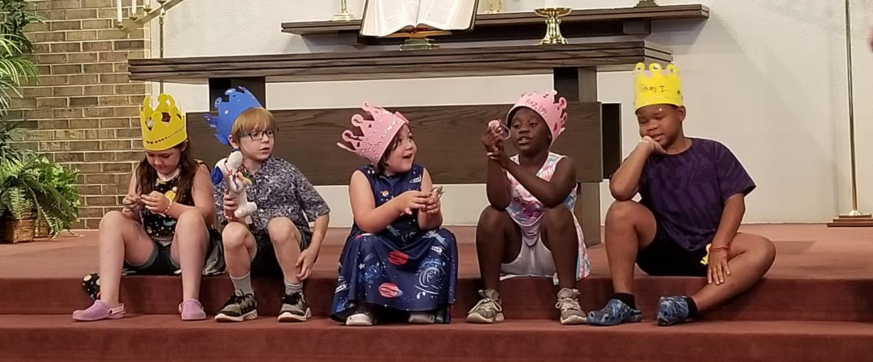
Youth in Worship

Slide 7
Worship on Scout Sunday – Eagle Scout Sophia Cochran

Slide 8
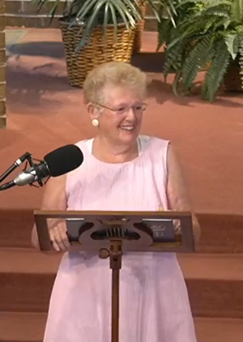
Music
Notes:
“We are thankful for the variety of music brought into our services.”

Slide 9
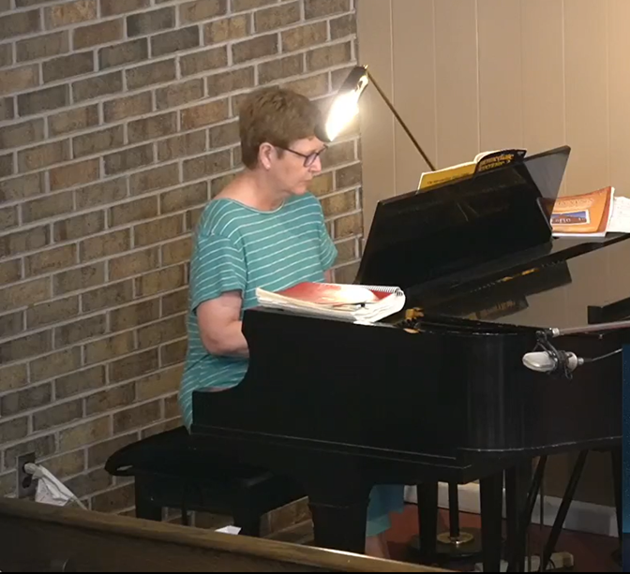
Music

Slide 10
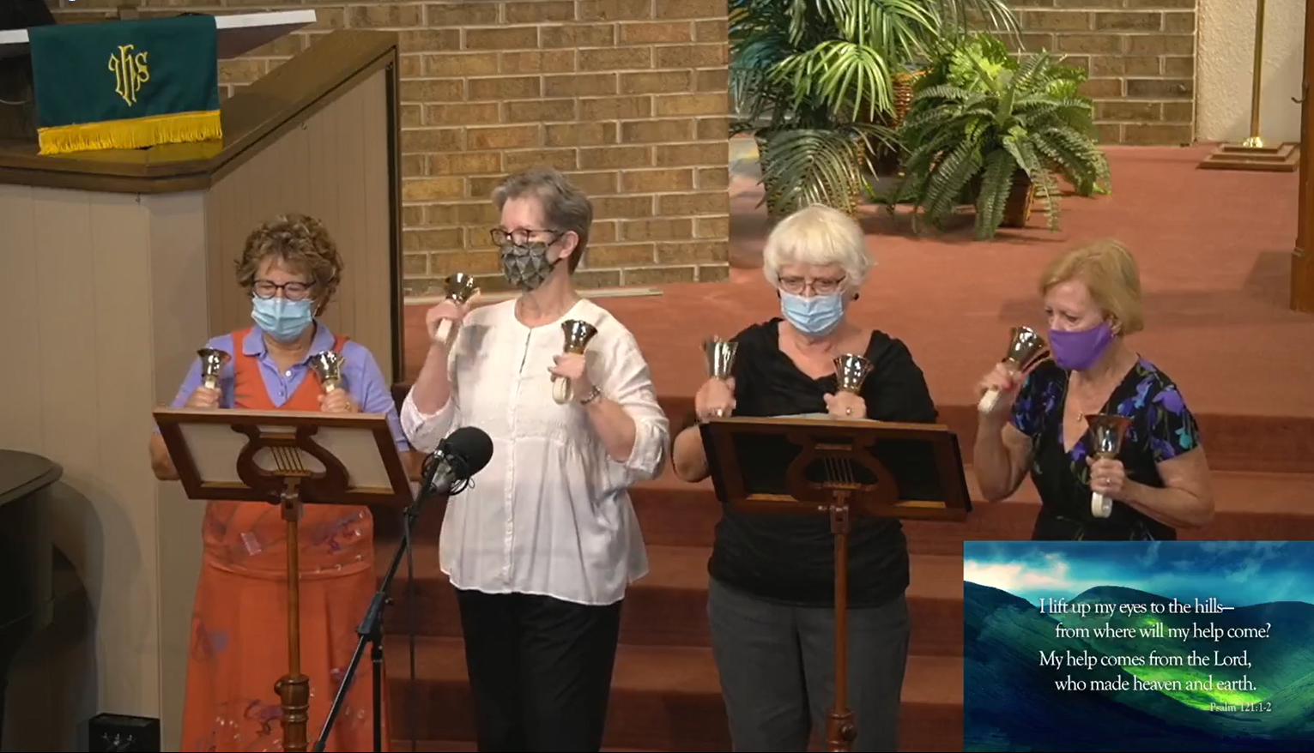
Music

Slide 11
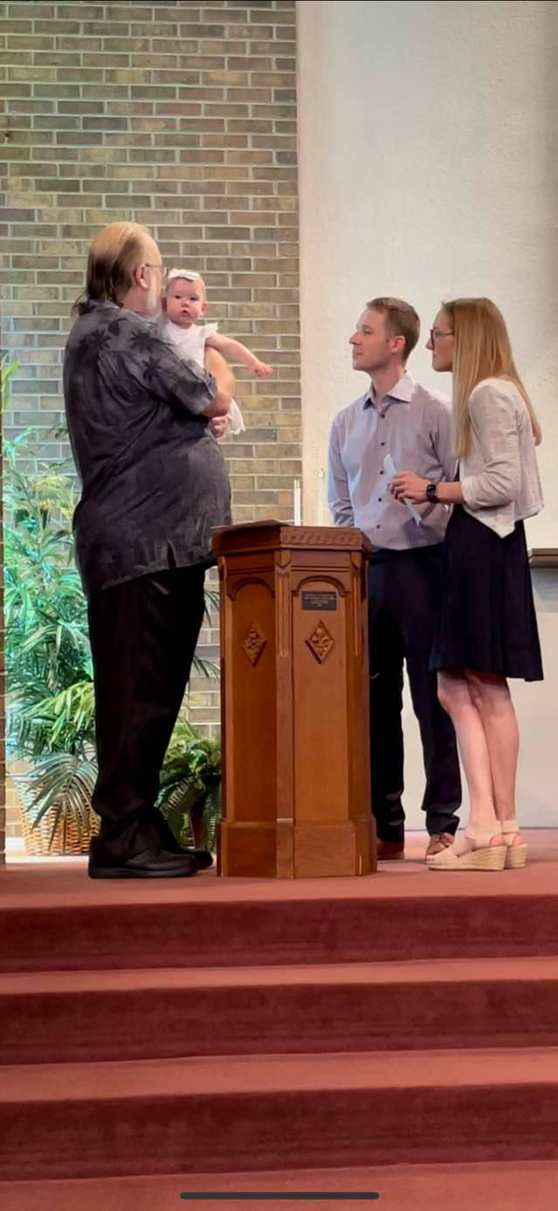
Baptisms

Slide 12
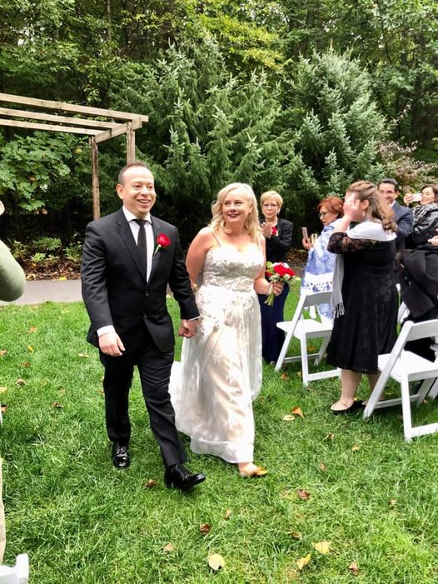
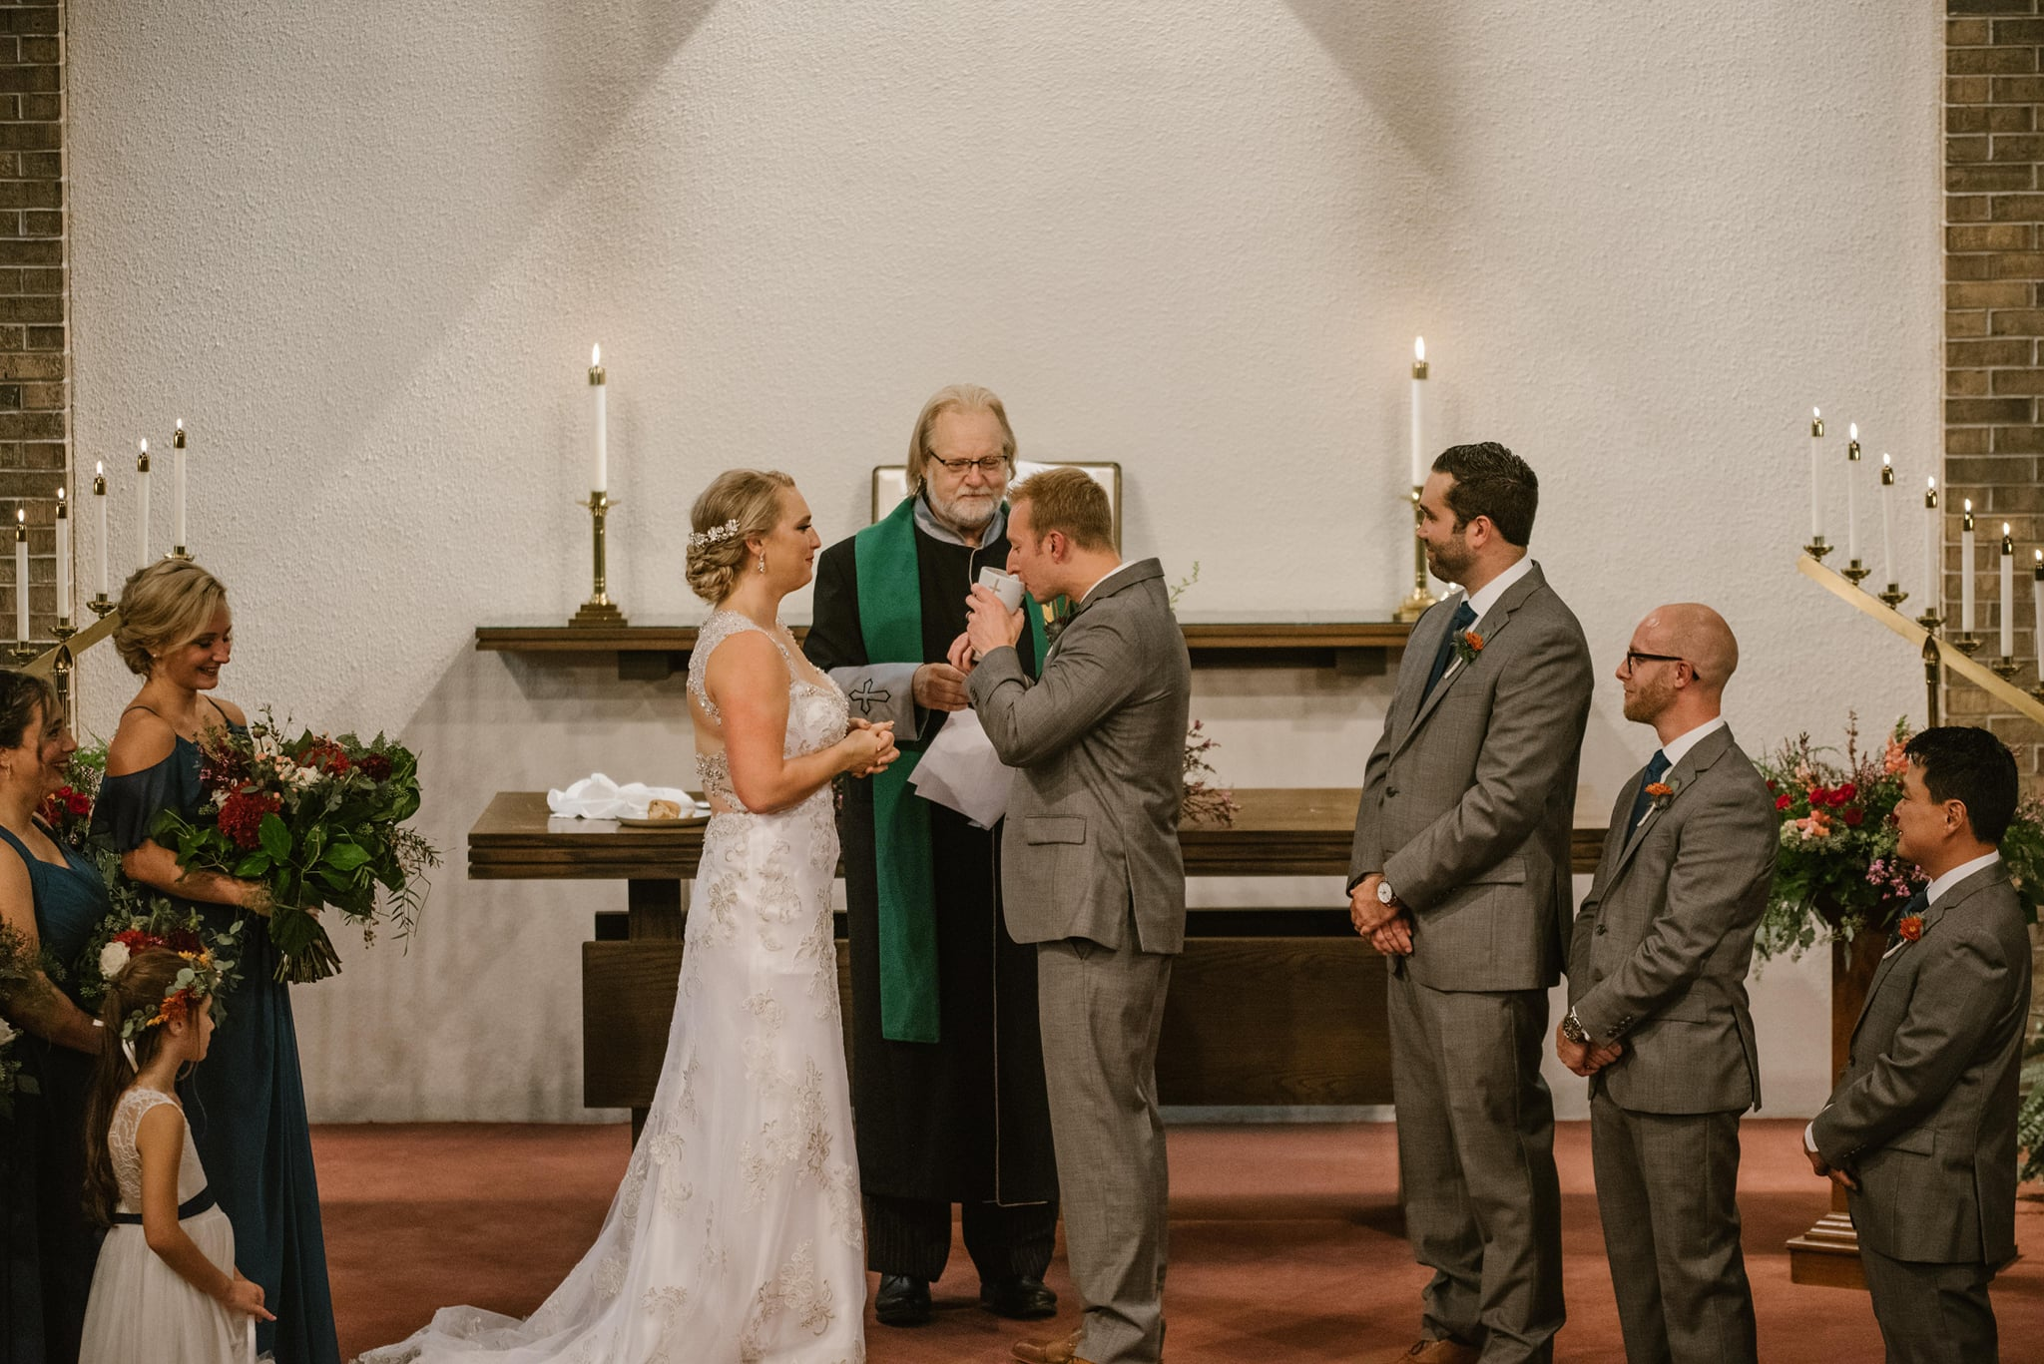
Weddings
Notes:
Every few years, we host the Baccalaureate service a few days before South Haven High School’s seniors graduate.

Slide 13
Confirmation
Congratulations to Erin Bos and Jocelyn Saucedo who joined the church through Confirmation.
Faith Spies was baptized and joined the church on the same day through Confirmation as well.

Slide 14
Graduate recognition
Notes:
Every few years, we host the Baccalaureate service a few days before South Haven High School’s seniors graduate.

Slide 15
On Sunday, November 15, 2020, First Congregational Church, UCC in South Haven MI, voted to officially become an “Open and Affirming” congregation.

Slide 16
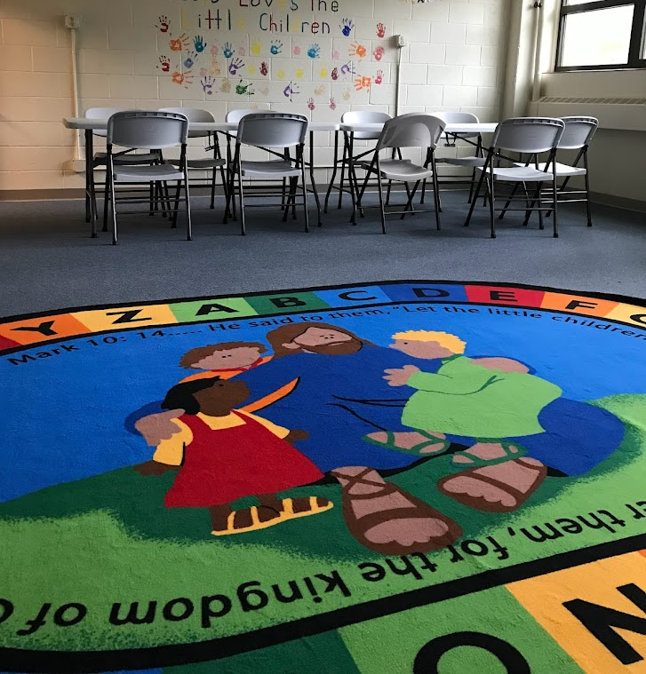
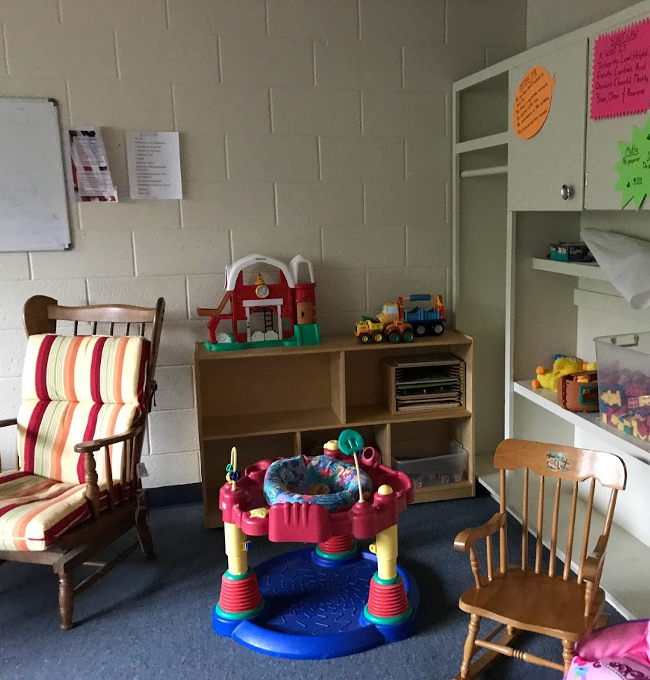
Christian Education

Slide 17
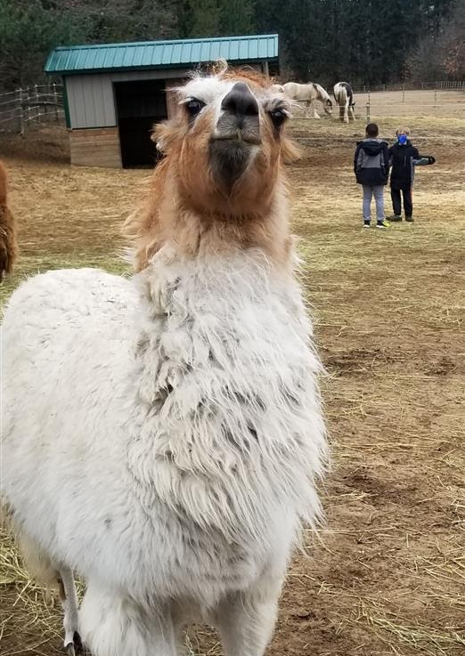
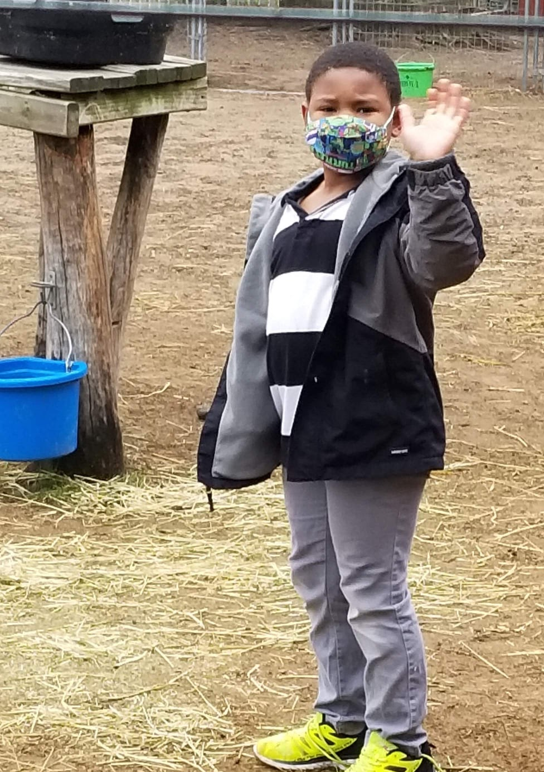
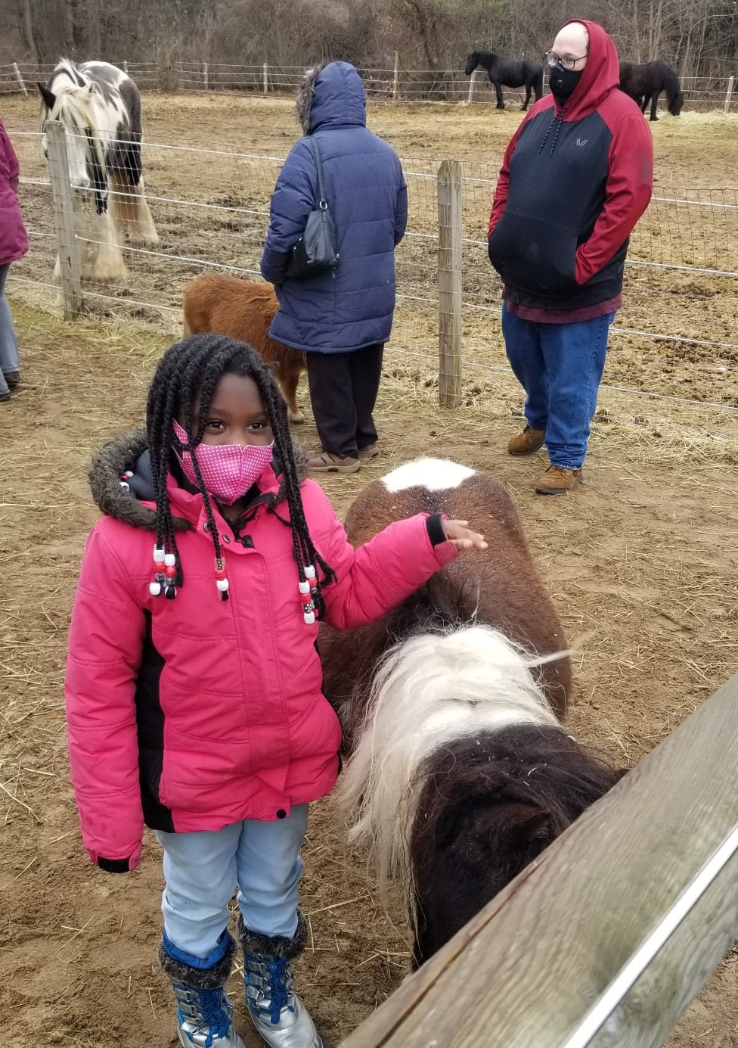
Children’s ministry A wonderful *cold* afternoon at Fellinlove Farms!
Notes:
“Here are three recent youth activities. In one photo our youth enjoyed a message from Mike Tupper at The Petting Zoo.”

Slide 18
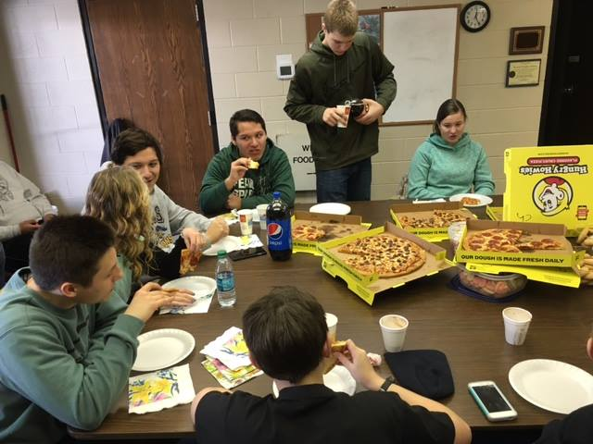
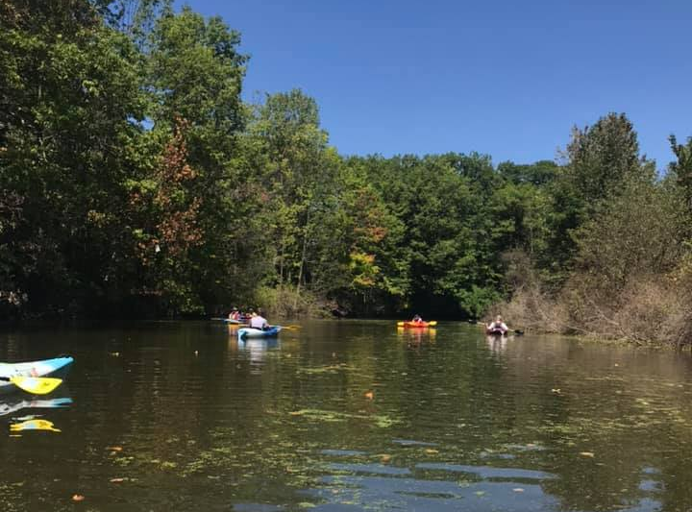
Youth and Young Adult activites

Slide 19
Book Studies and DVD series
The Early Church DVDs

Slide 20
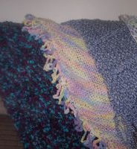
Caring for Each Other

Slide 21
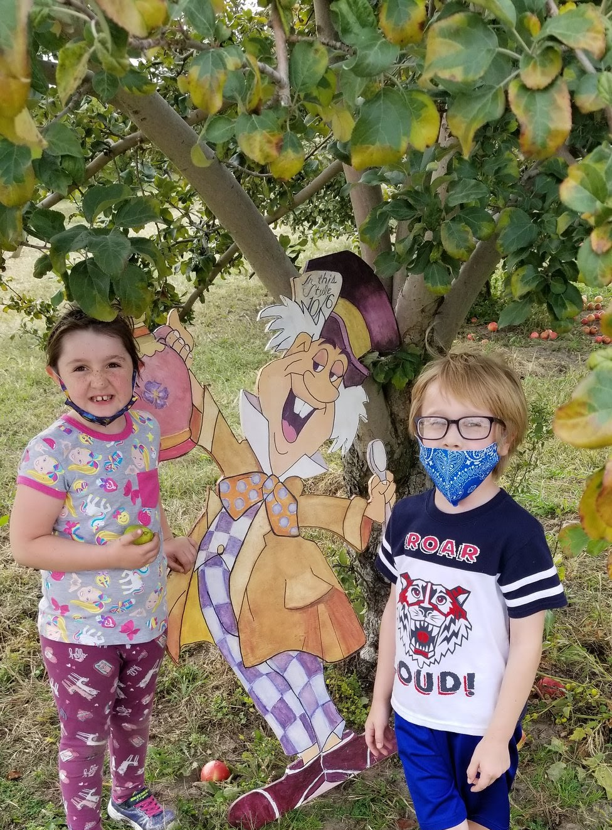
Fun at the Rood Centennial Farm

Slide 22
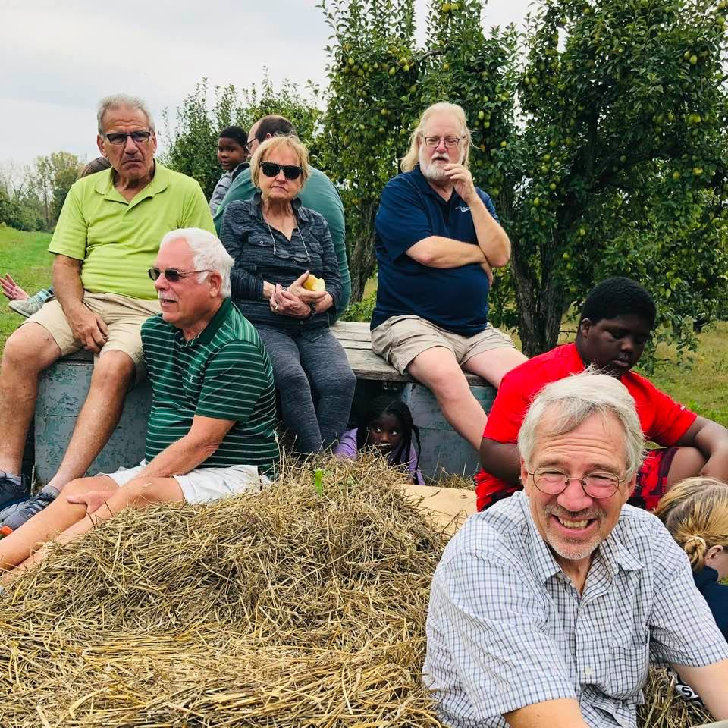
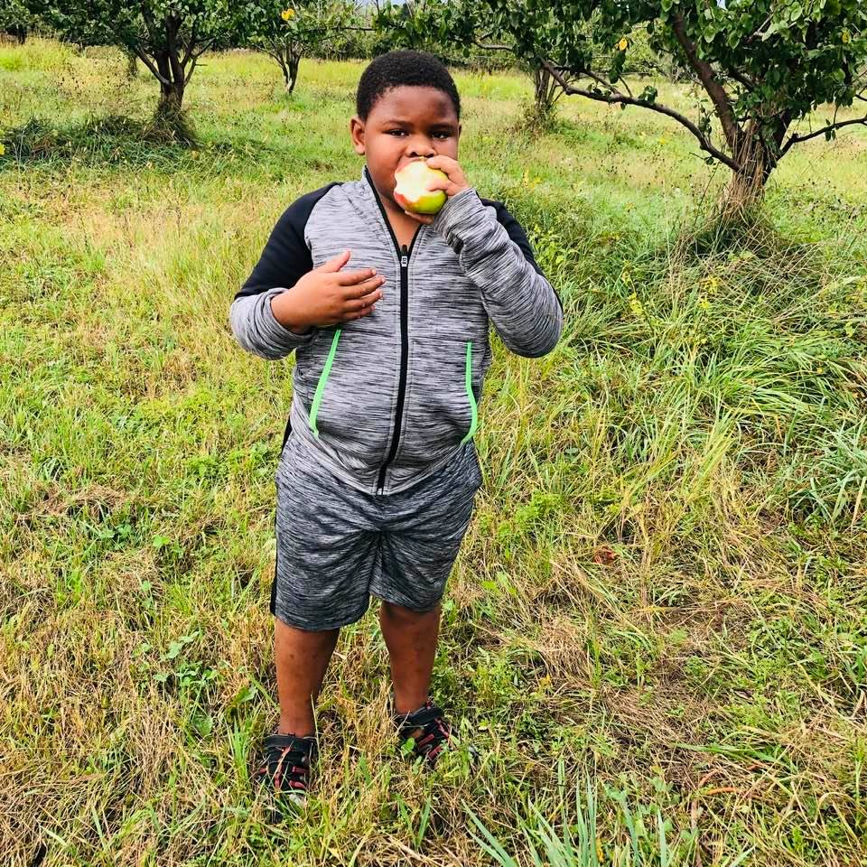
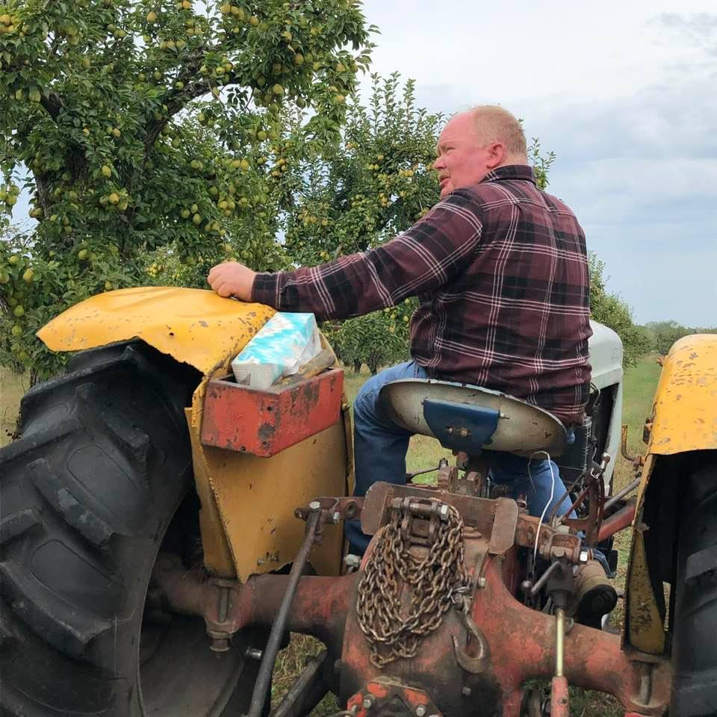
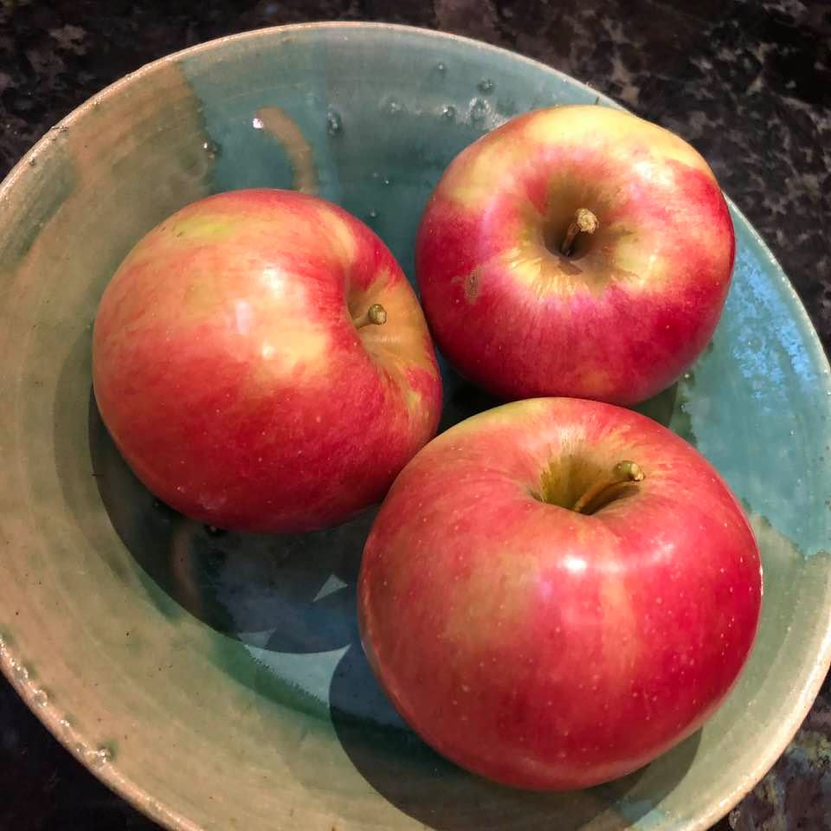
Hayride at the Rood Centennial Farm

Slide 23
Bike Group

Slide 24
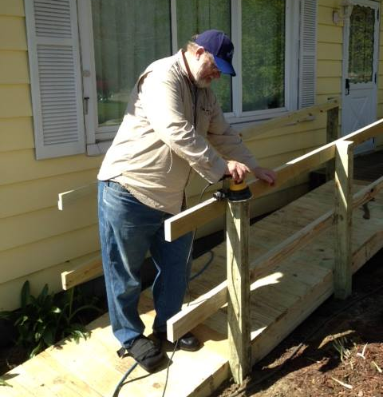
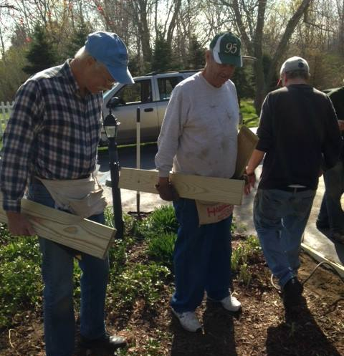
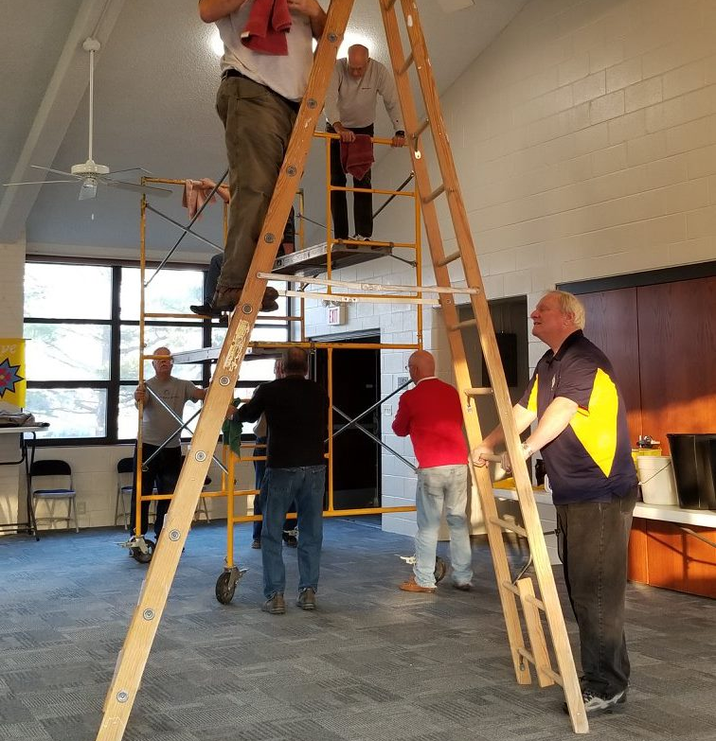
Men’s group building ramps and caring for church building

Slide 25
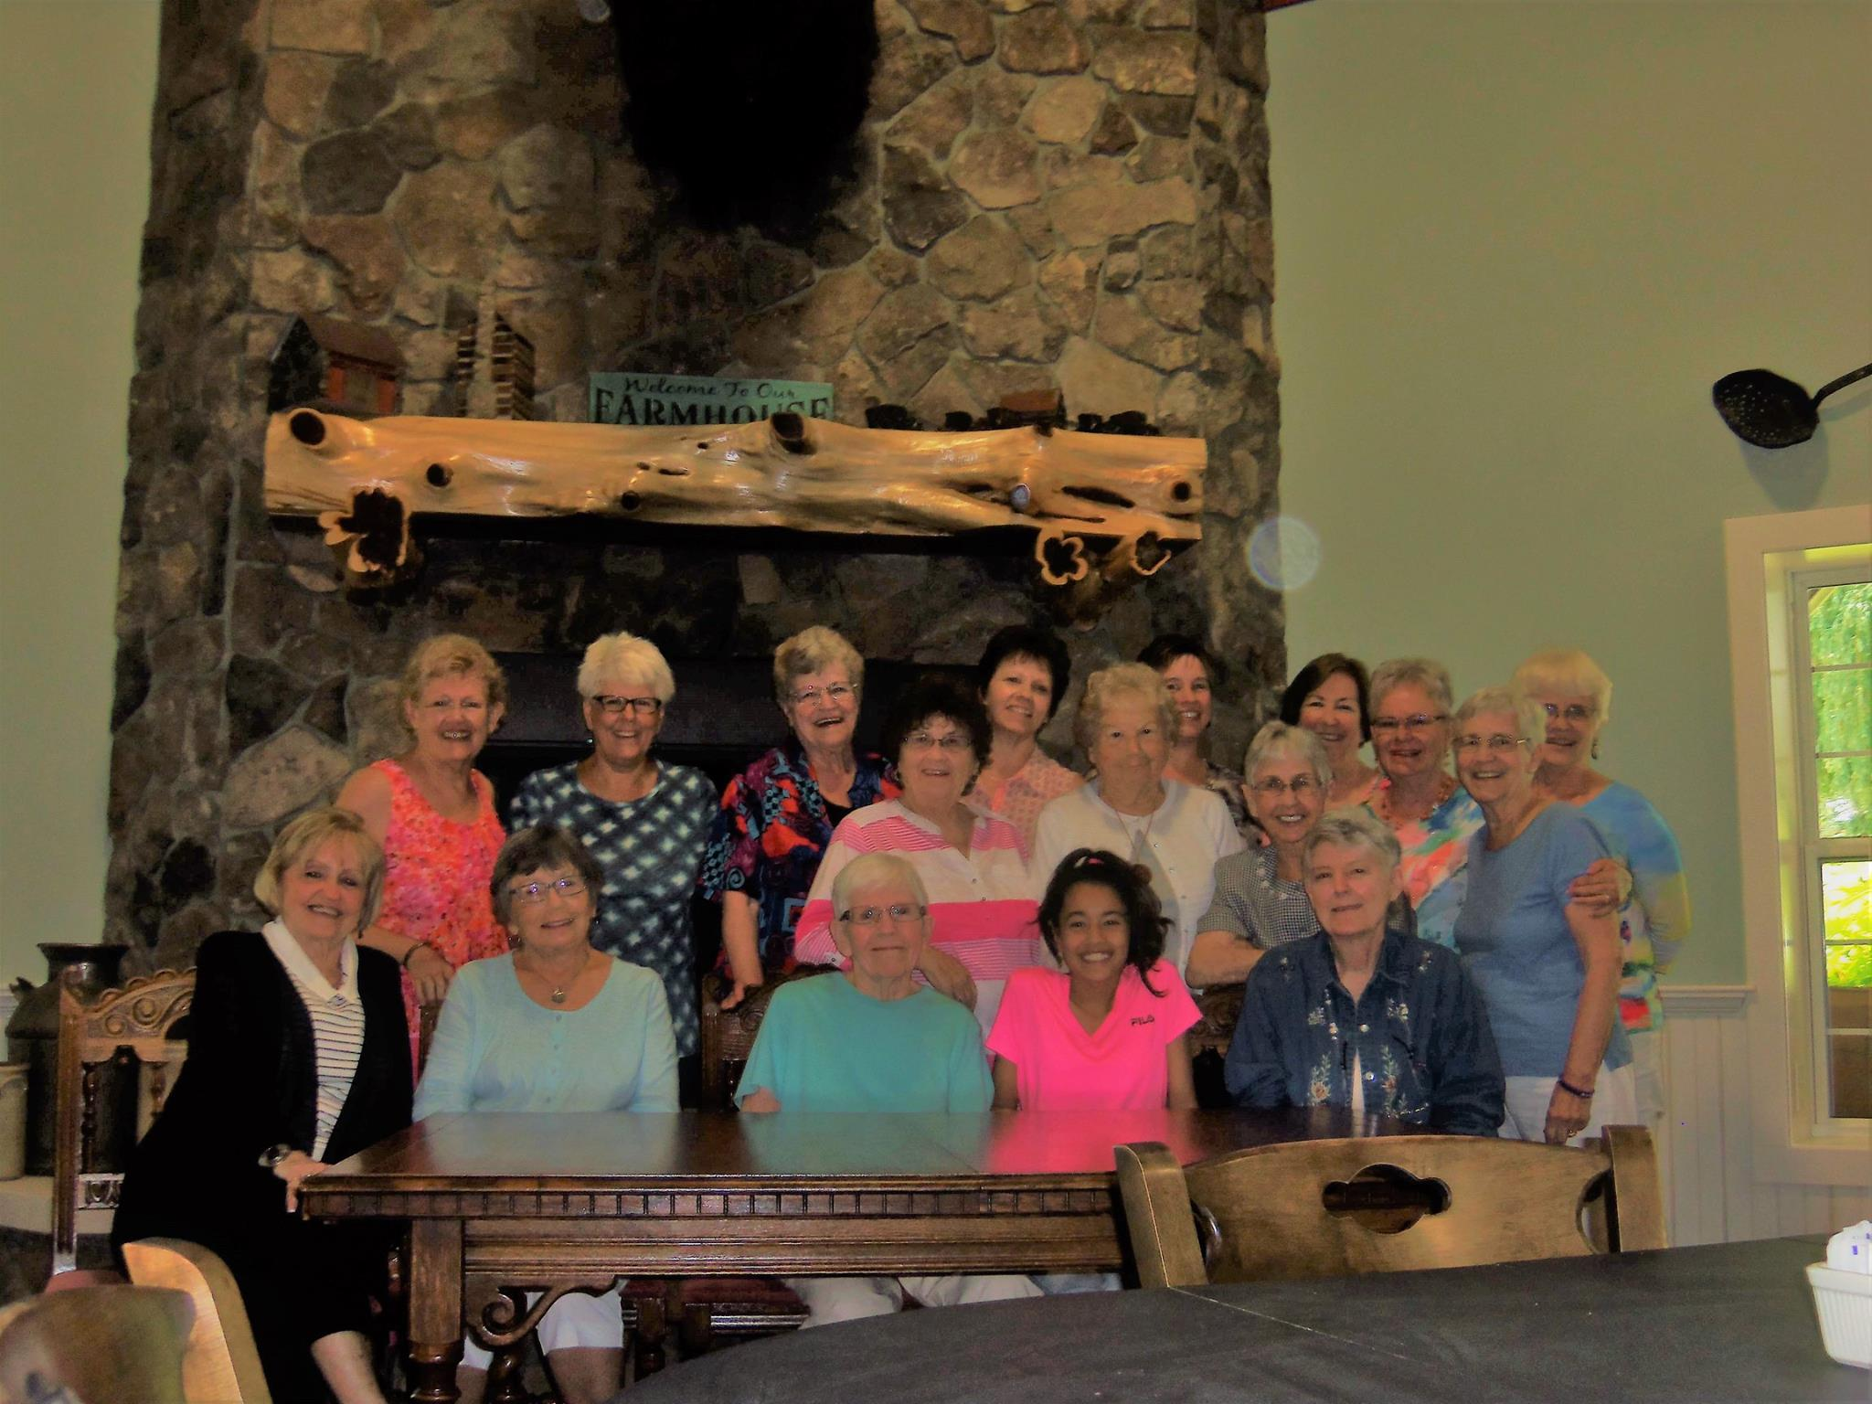
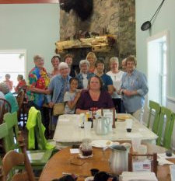
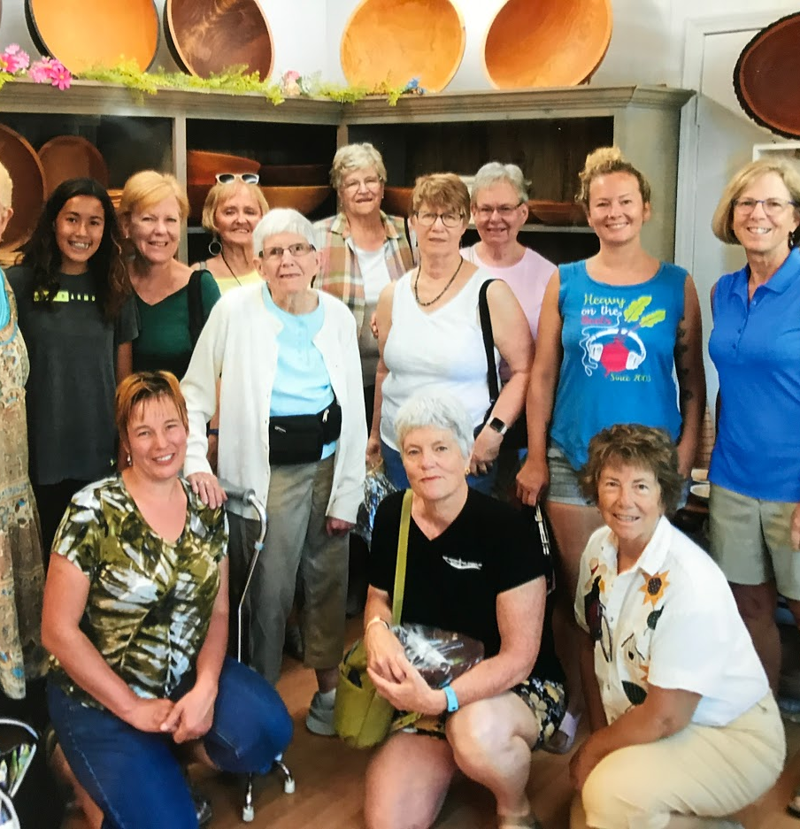
Women’s fellowship

Slide 26
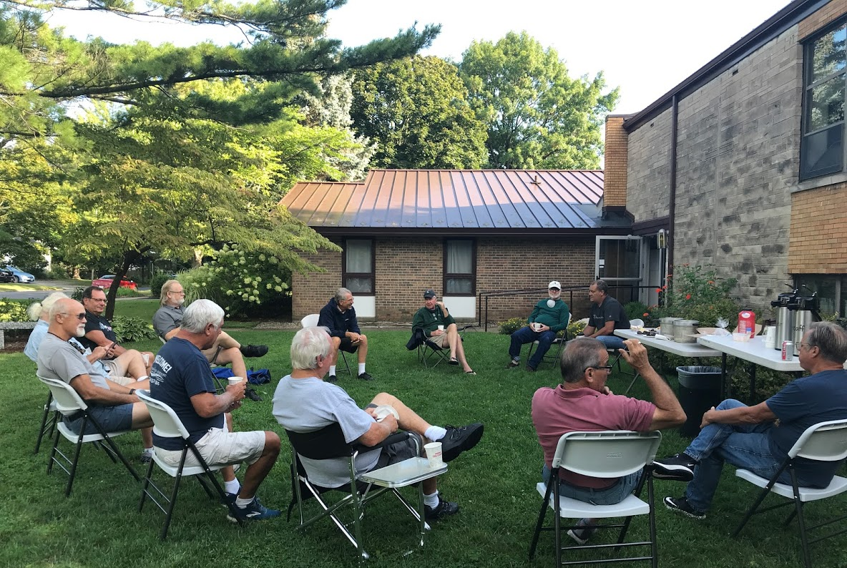
Men’s breakfast

Slide 27
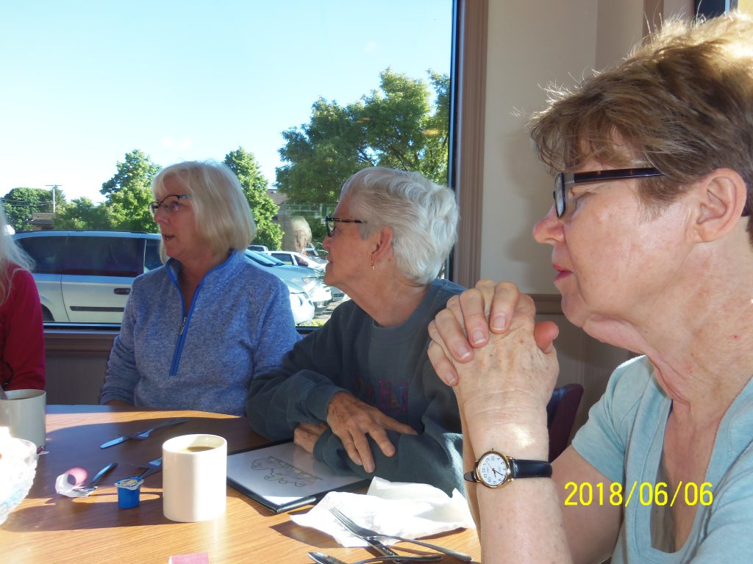
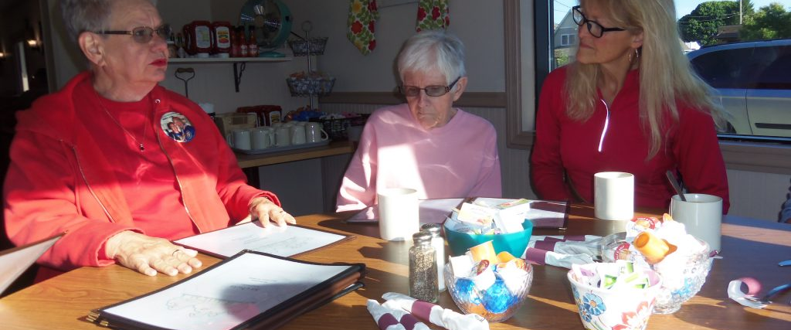
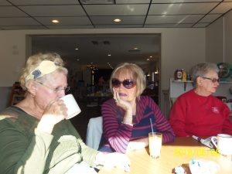
Women’s breakfast

Slide 28
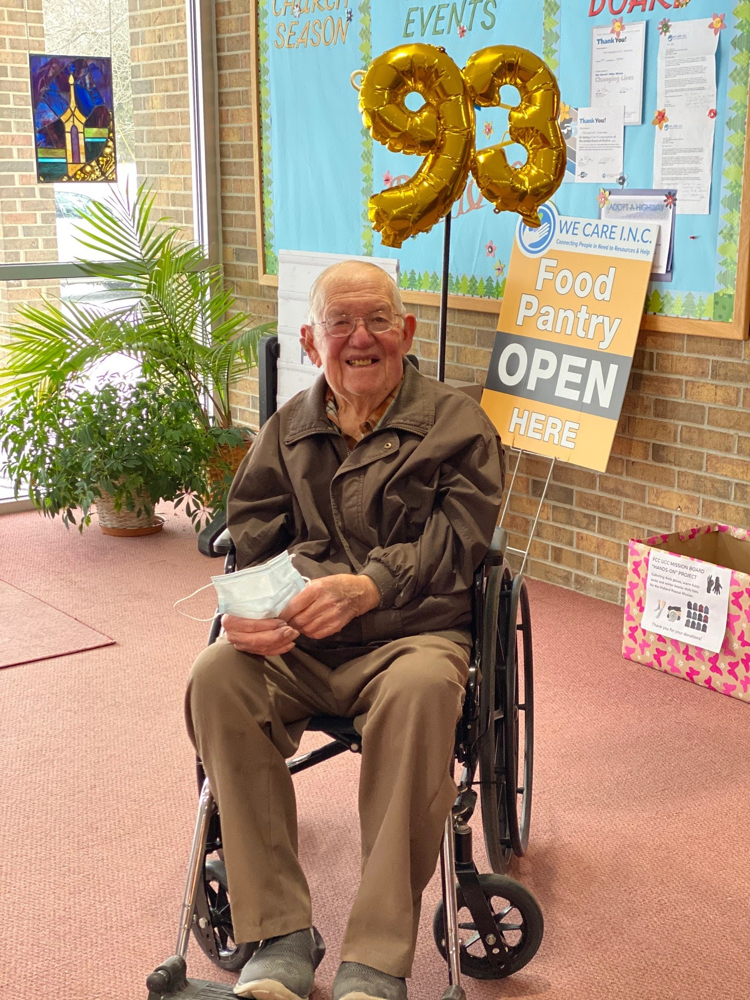
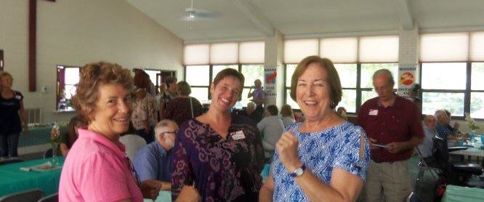
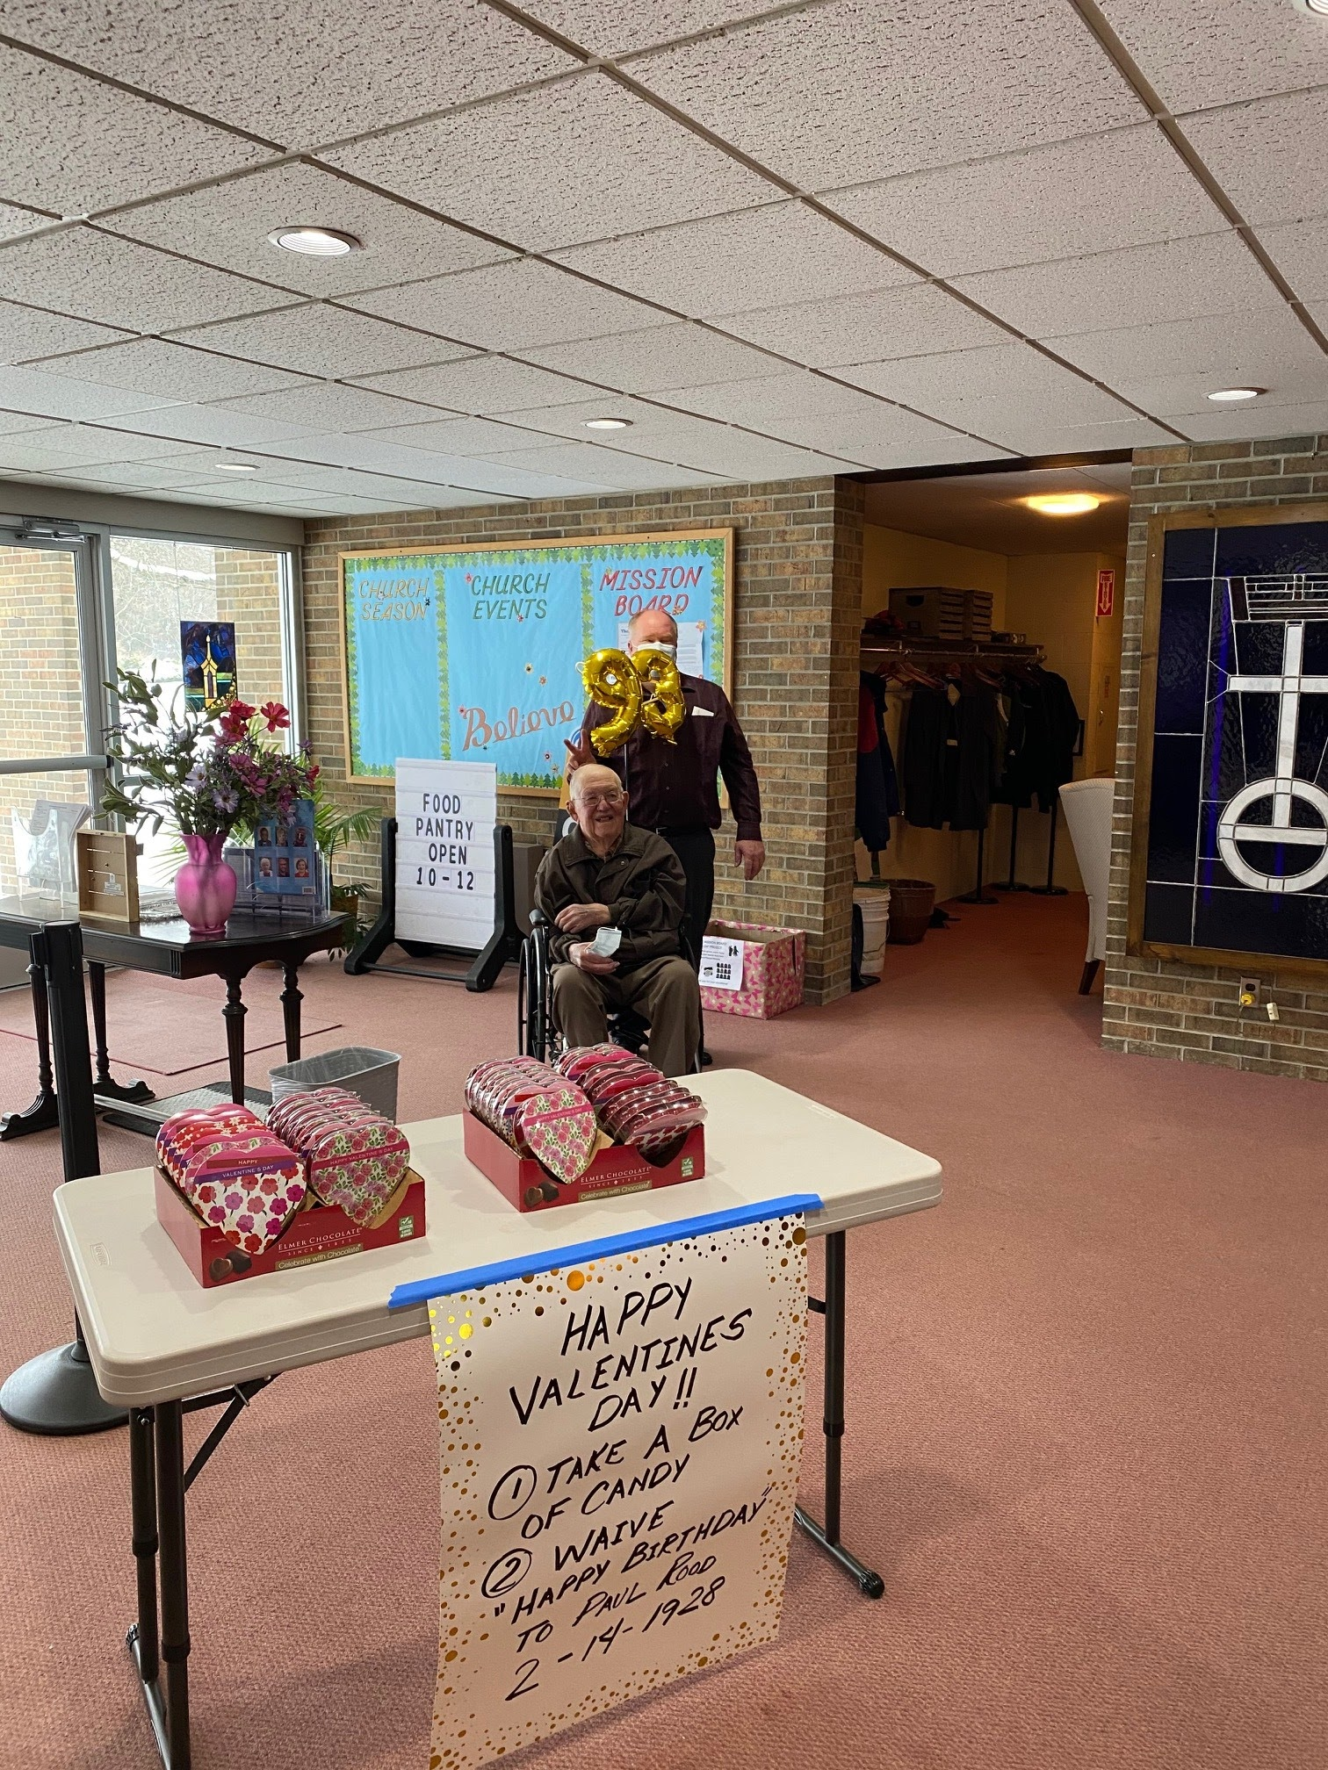
Food and Fellowship
Birthday celebrations

Slide 29
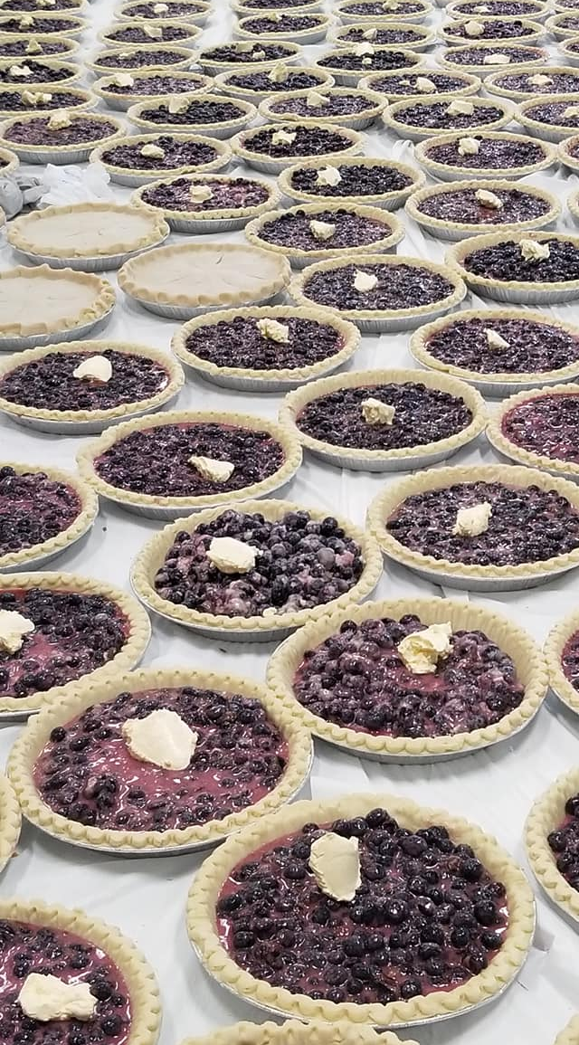
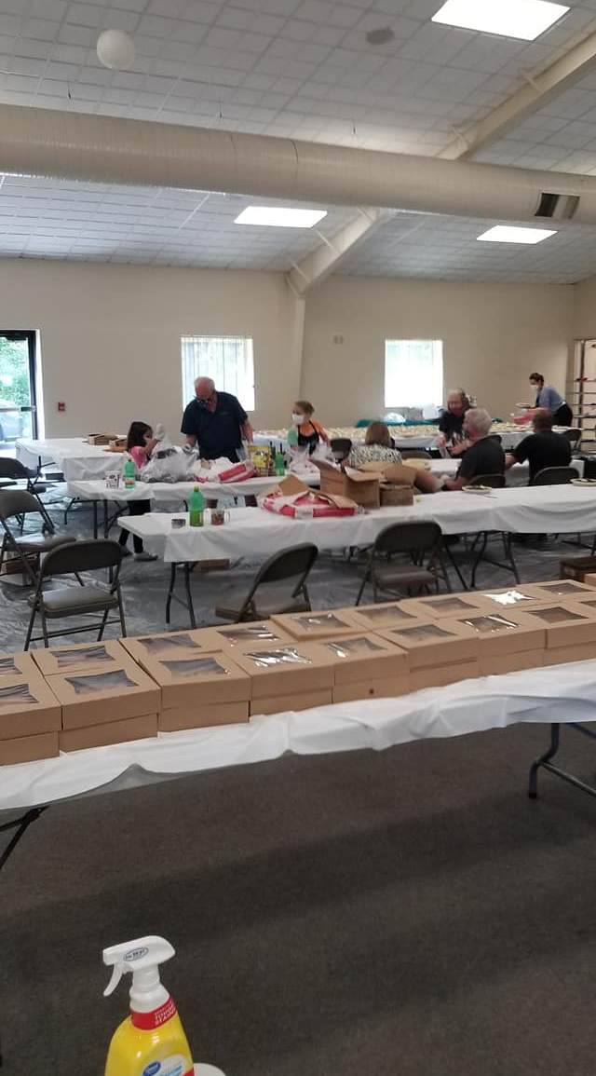
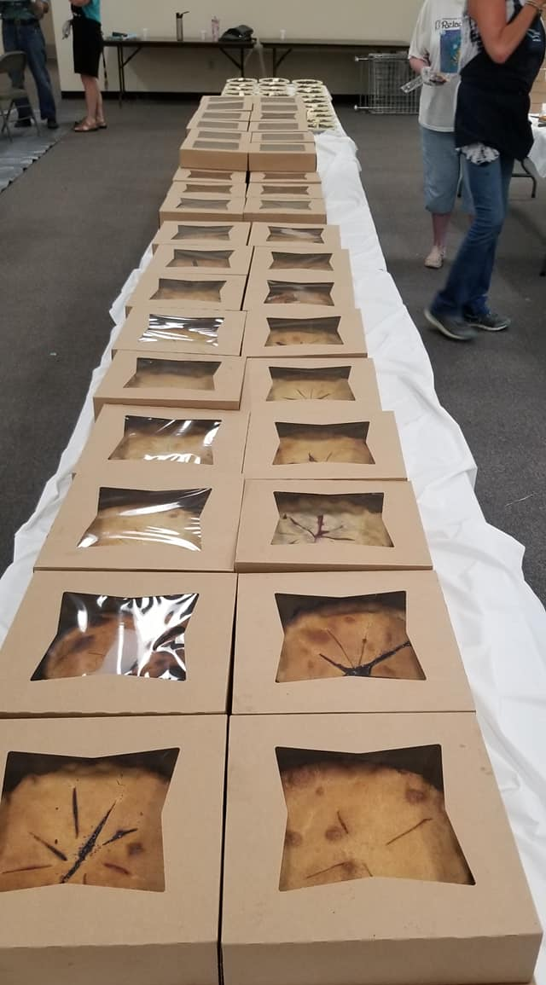
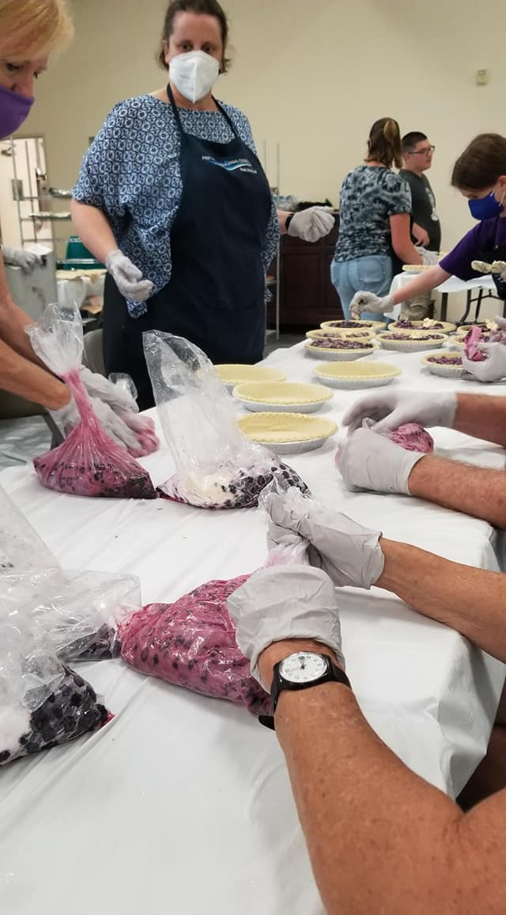
Blueberry Festival

Slide 30
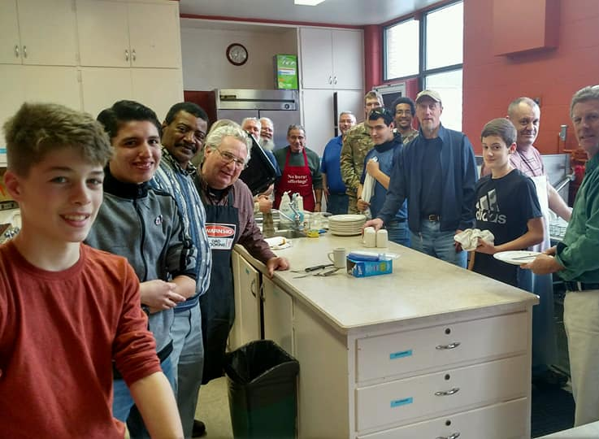
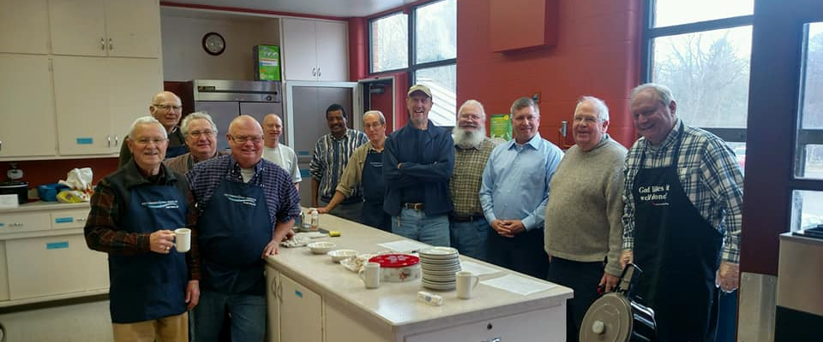
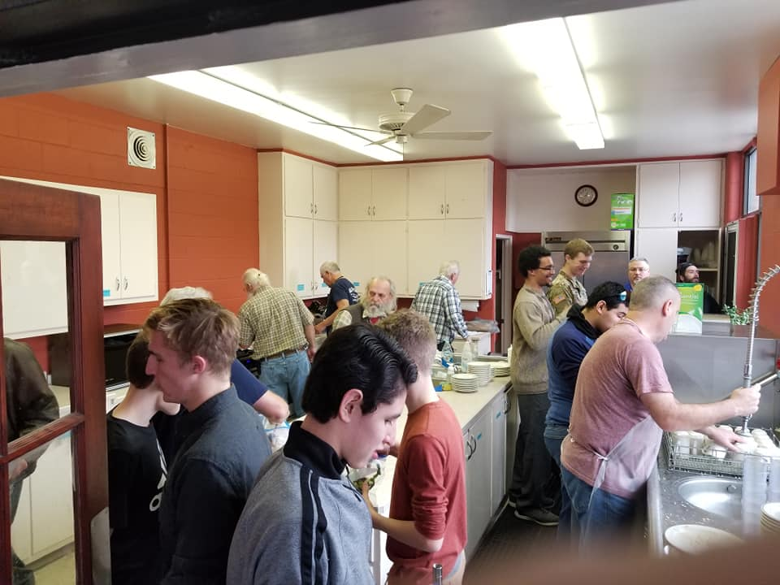
Smoked Turkey Dinner

Slide 31
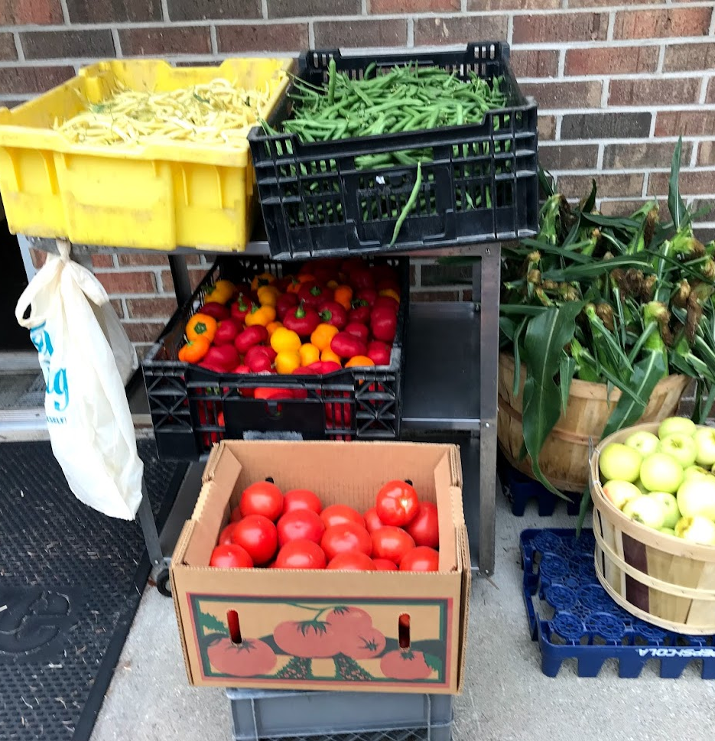
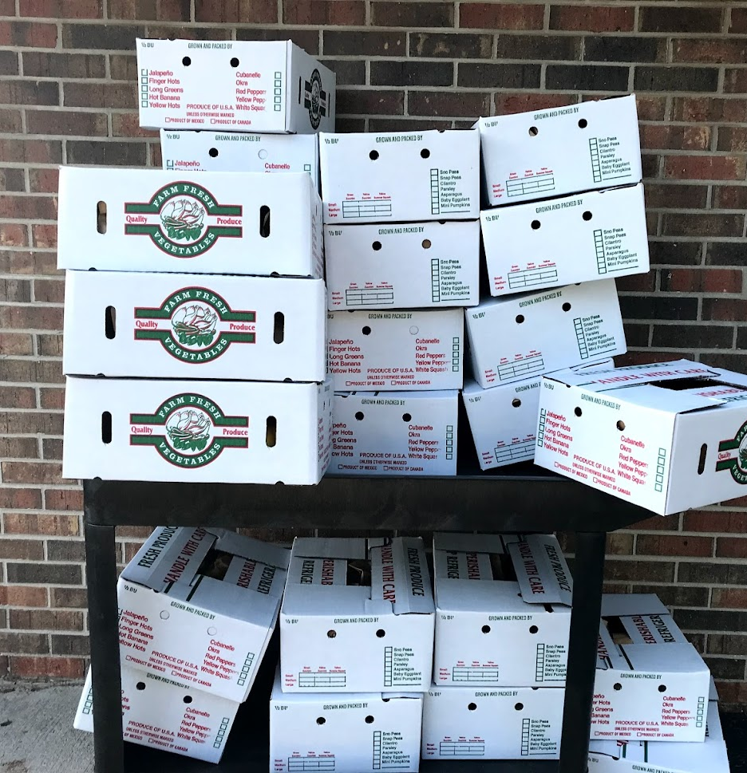
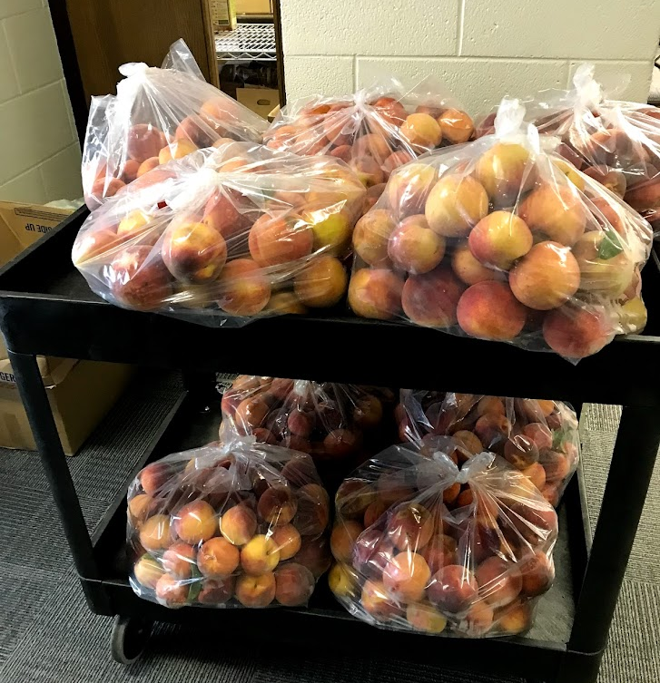
Feeding the hungry

Slide 32
Feeding the hungry
Notes:
“Distribution of food has increased dramatically during the Covid pandemic. The food pantry has been serving between 80-90 households per week. The week of September 21, we served 99 households.”

Slide 33
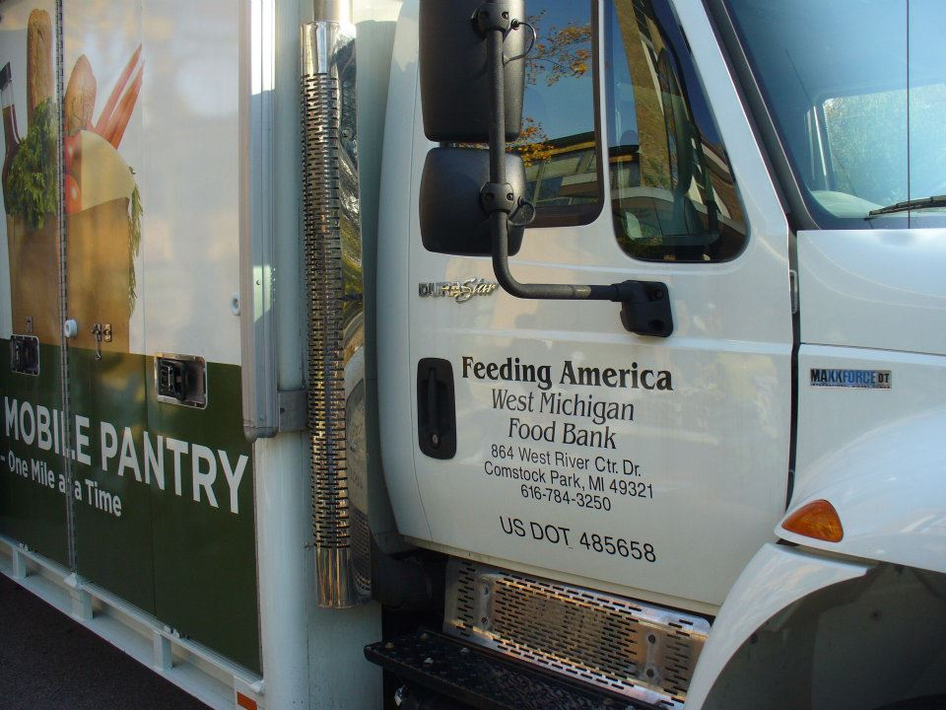
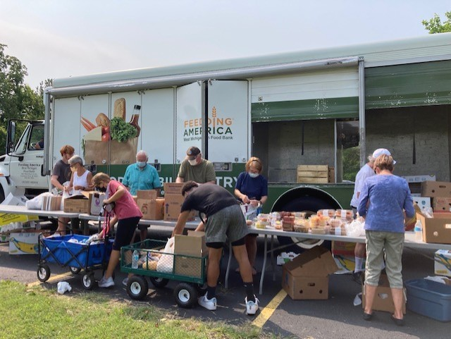
Feeding the Hungry – Feeding America Food Trucks
Notes:
“A truck from Feeding America set up shop in our parking lot. There are four food trucks scheduled for this year. The last one on September 3rd served 97 families and had to close down after 1 hour when the food was all given out.”

Slide 34
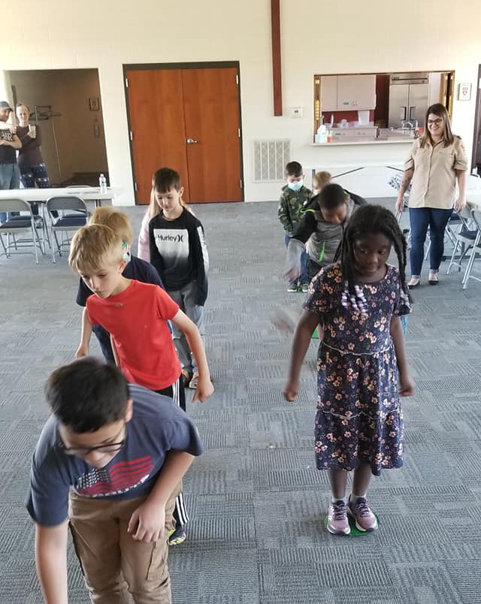
Scouts

Slide 35
Notes:
Centered on Wellness was previously called the Samaritan Center.

Slide 36
Supporting the Good Shepherd Orphanage
Notes:
“Some of our members are shown helping Haiti residents clean-up a roadside.”

Slide 37
Highway Cleanup
Notes:
“Speaking of cleaning roadsides…….We have our own section of M140 that we keep clean.”

Slide 38
Warm Your Heart fundraiser

Slide 39
Mission and Outreach

Slide 40
Quilts for Domestic Violence Coalition

Slide 41
God IS STILL SPEAKING…..our next chapter
Our beloved Senior Pastor Jeffrey announces he will retire on May 1, 2022
Notes:
Read this slide aloud.

